Slide 1
Exploratory Data Analysis Data set: Used Cars Sales

Slide 2
Project analysis slide 2
Introduction
Analysis
Focus on immediate
revenue generation
Market Study in India
Sales - 4.3 Million
Growth - 18%
Holding Time - 3 to 4 Years
Used Cars Resellers
Strategic approach
Differentiated Business models
Increasing the Buyer-enthusiasm
Segments
Organized
Unorganized
Challenges
Trustworthiness from customer’s view
Quality of cars
Target segment for EDA
Organized

Slide 3
Project analysis slide 4
Problem Statement
To Perform Exploratory Data Analysis (EDA) in order to update the strategy and shift focus on clearance of unsold cars residing for > 10 years and bringing in new process of keeping only registered cars, both of which would derive immediate revenue generation
Understanding of what aspects attribute to high selling power of some brands
Top Selling cars and their statistics
Revenue Generation on Non-Registered Vehicles.
Price optimization for higher sales
Management Objectives
Assumptions & Hypothesis
EDA
Price efficiency of cars
Price distributions and optimization
Quality of cars
Registered and thoroughly processed documentation.
Customer Needs
Reasons of lower selling power of some cars based on available dataset
Least selling cars and improvements

Slide 4
Project analysis slide 3
Exploratory Data Analysis Used Cars Sales Dataset
Data Acquisition & Description
Data Pre-Profiling
Data Post-Processing
Data Post Profiling
Exploratory Data Analysis
Dataset was cleaned and processed by:
Dropping duplicates
Missing values in drive column can be handled by filling with MODE of the drive column
Missing values in engV column can be handled by replacing the NA with 30, as 30 is the max value that petrol and diesel engines of the car make/model that are present in the given dataset
The zero in Price column can be replaced by mean of prices
The zero in mileage column should be treated as outlier and has to be handled
The Dataset is acquired by a secondary source, containing prices of used cars with specific features like Make, Model, Year etc.
113 Duplicates
434 missing values in engine version column and 511 values missing under drive column
0 as value in 267 rows in price and 348 rows in mileage columns.
Outliers in engV column
Conclusions and Insights derived by analysis the observations

Slide 5
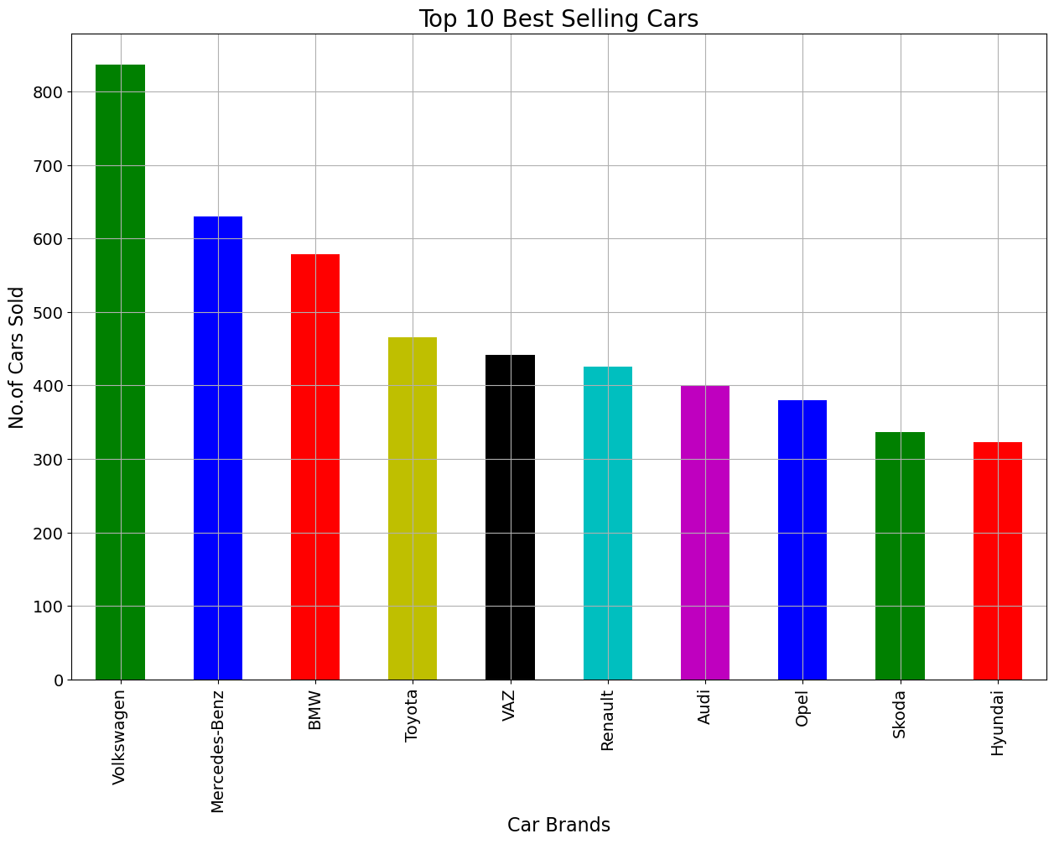
Project analysis slide 5
Top 10 Best Selling cars
#1 Best Seller Volkswagen
#2 Mercedes Benz
#3 BMW
800+
600+
500+

Slide 6
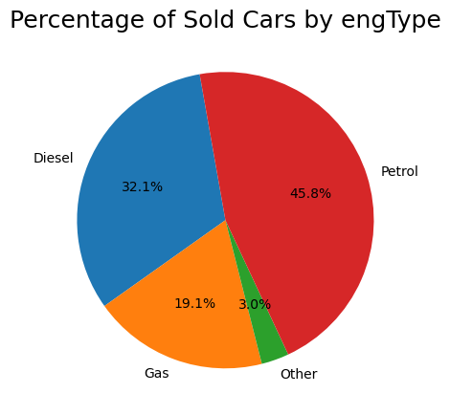
Project analysis slide 5
Percentage of sold cars
Highlight: The percentage of OTHER depicting Electric cars is very low dragging the attention on coming up new strategy on reselling used Electric cars in coming years
#1 Best Seller Petrol cars
#2 Diesel cars
45.8%
32.1%

Slide 7
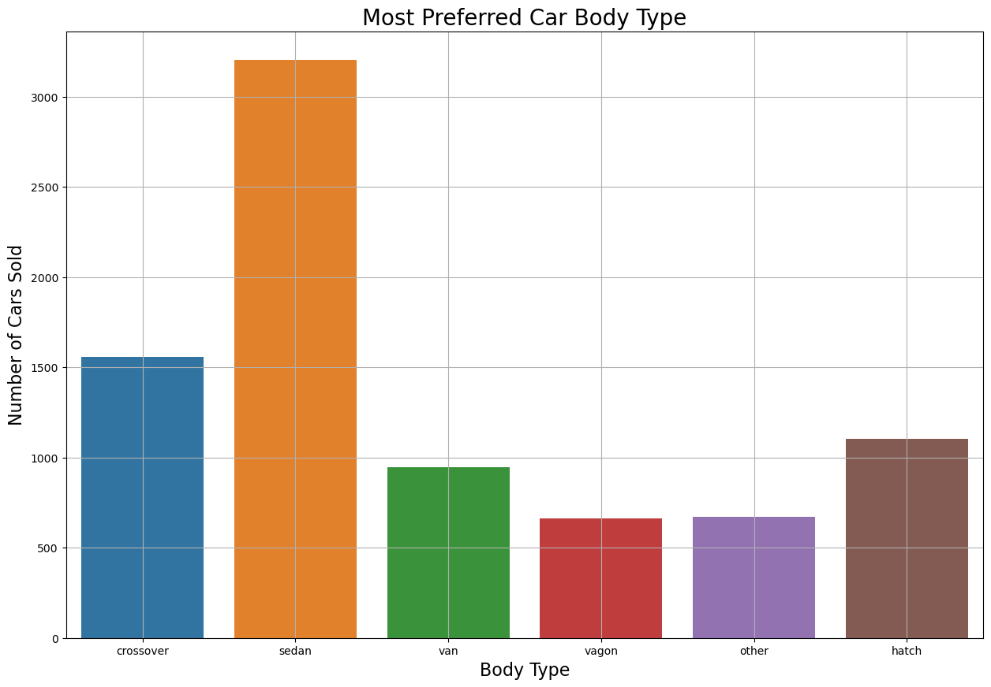
Project analysis slide 5
Most Preferred car type
#1 Preferred Body type
#2 Preferred Body type
Sedan
Crossover

Slide 8
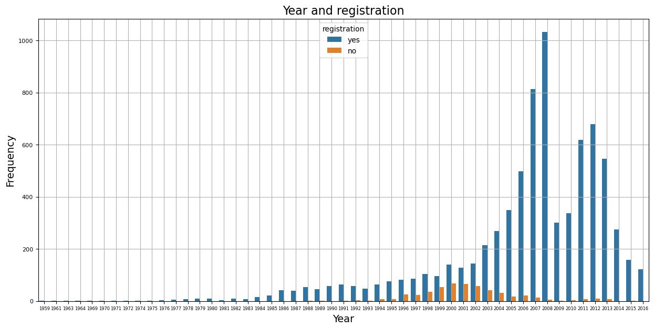
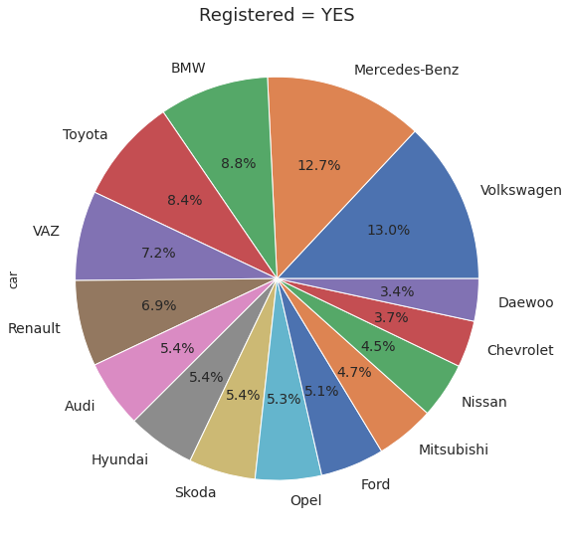
Project analysis slide 7
Non-Registered cars
13% percent shares of registration is almost for 2 of the top selling brands – Volkswagen and Mercedes Benz
Non-registered cars are normally distributed between years 1992 and 2005
1)The non-registered vehicles in years 1992 and 2005 need to be sold faster than the rest of the cars
2) The non-registered vehicles after 2002 could be the 1st priority of sales

Slide 9
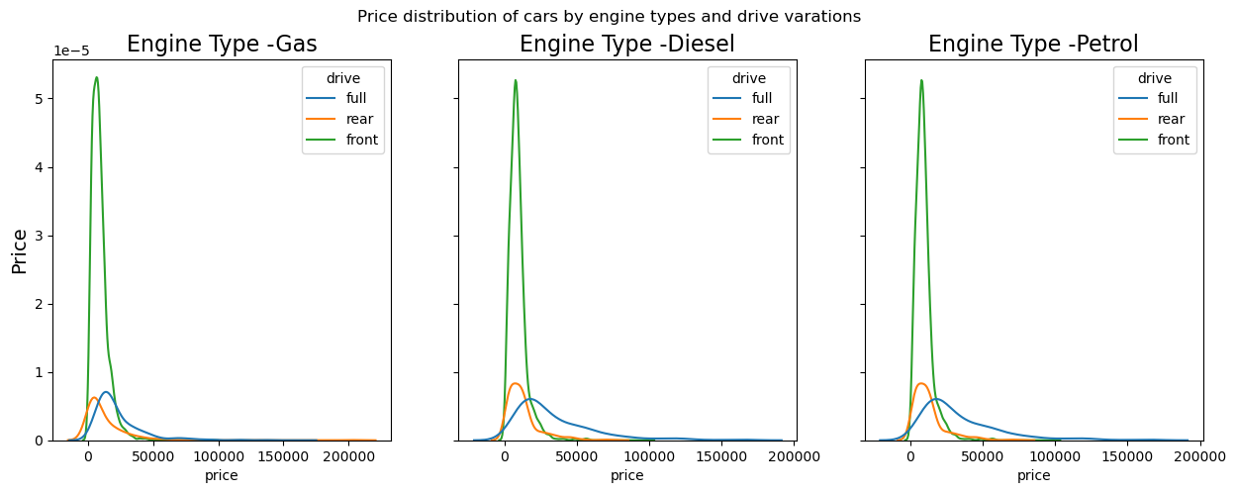
Project analysis slide 6
Price distribution for cars based on engine and drive type
PRICE OPTIMIZATION is a call for action
There is a right skew on all the 3 cases indicating more higher priced vehicles in the dataset. This could be looked at and worked upon

Slide 10
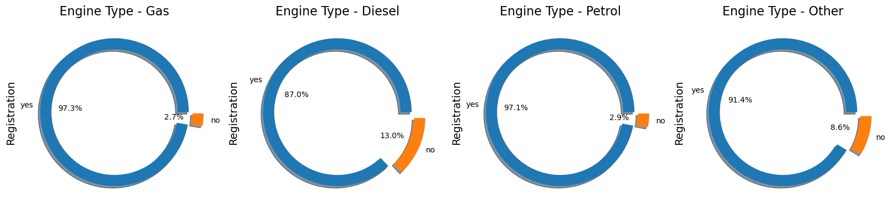
Project analysis slide 6
Non-Registered vehicles across Engine types
There are around 2.8% non-registered petrol engine vehicles and 12.2% of those for diesel engine vehicles
The used car dealer has to work on process improvement in having all their used cars registered; in the order of diesel engine vehicles first as this would help sell them faster yielding to quicker revenue

Slide 11
Project analysis slide 8
EDA outcome
Conclusion
Insights
These points could give a direction in terms of improvements and immediate actionable
Petrol cars are most sold engine types and Other (Electric etc.) are the least sold
Non-registered cars are normally distributed between years 1992 and 2005
The density distribution of car price is not a normal distribution and is right skewed. The dataset's lower bounds for price are extremely low relative to the rest of the data, this is causing the data to skew right.
The prices of Petrol cars, Diesel cars and Gas cars are normally distributed.
There are around 2.8% non-registered petrol engine vehicles and 12.2% of those for diesel engine vehicles
Sedan is the most favorite car body style that customers prefer followed by crossover.
If the used car dealer has to enter the market of reselling Electric cars, a new strategy should be considered in selling
The non-registered vehicles in years 1992 and 2005 needs to be worked upon and the non-registered vehicles after 2002 could be the 1st priority of sales
The lower boundaries of the price of cars needs some more attention and needs to increase to effect in a normal distribution
The used car dealer has to work on process improvement in having all their used cars registered; in the order of diesel engine vehicles first as this would help sell them faster yielding to quicker revenue

Slide 12
Thank You

